Slide 1






Milestone 4:
Health Monitoring App
Group 3: Alexandra Anthony, Sara Gaber, Ahmad Shah, Neeti Mistry, & Sohan Chatterjee
Notes:
Alex: 1, 2, 3, 4
Ahmad: 7
Sara: 6
Neeti: 5, 7
Sohan: 8, 9

Slide 2


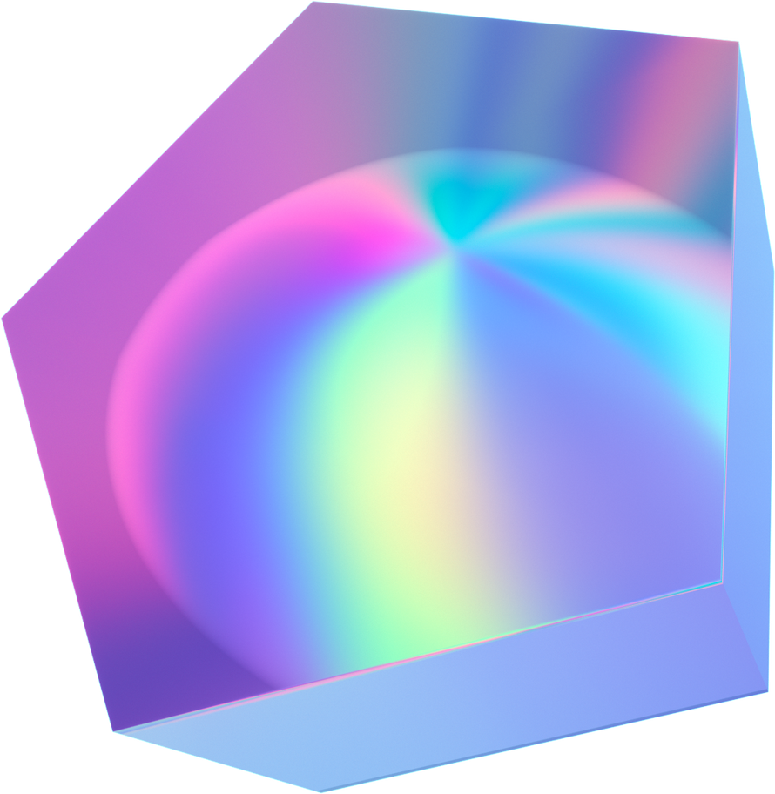
Team Management
Team member responsibilities and effort estimation

Slide 3
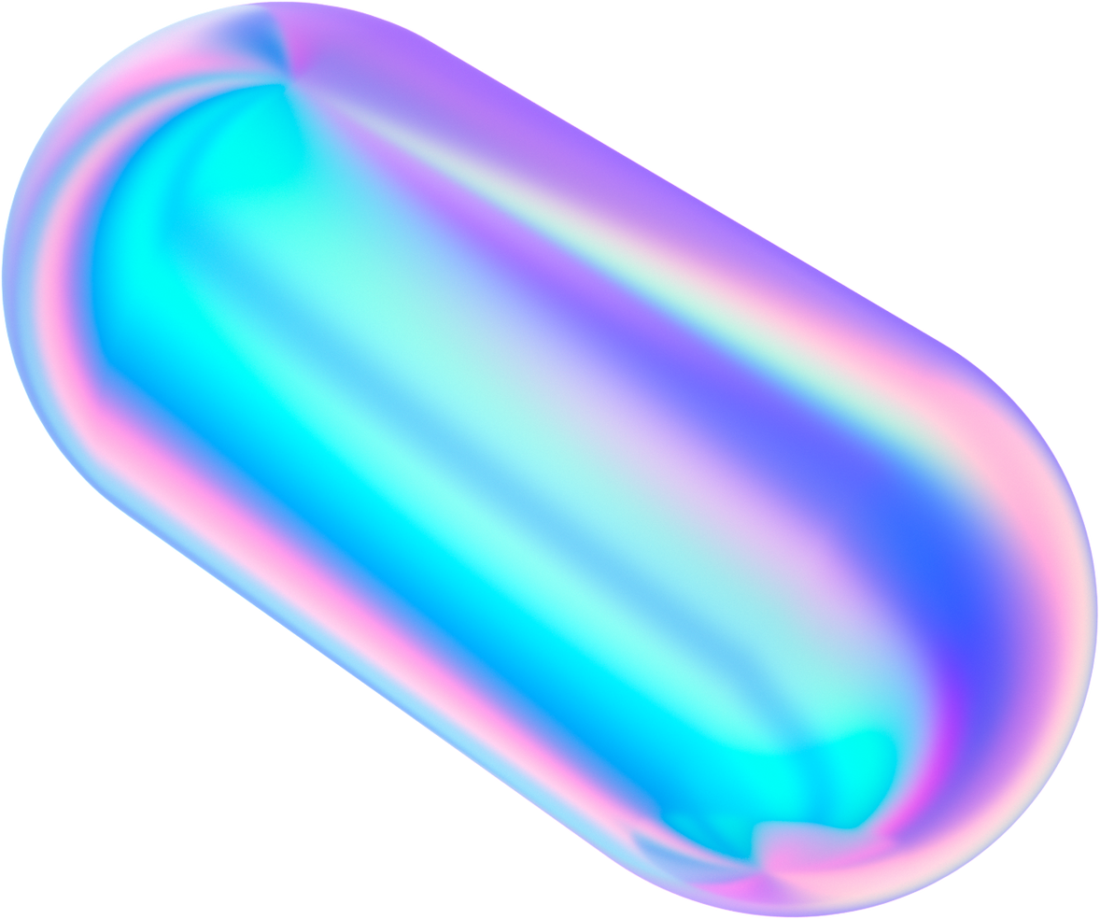
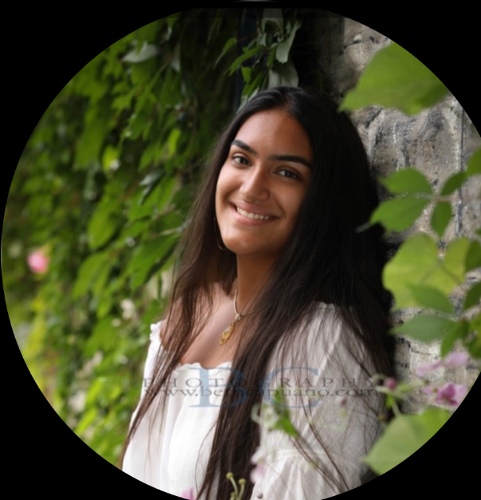
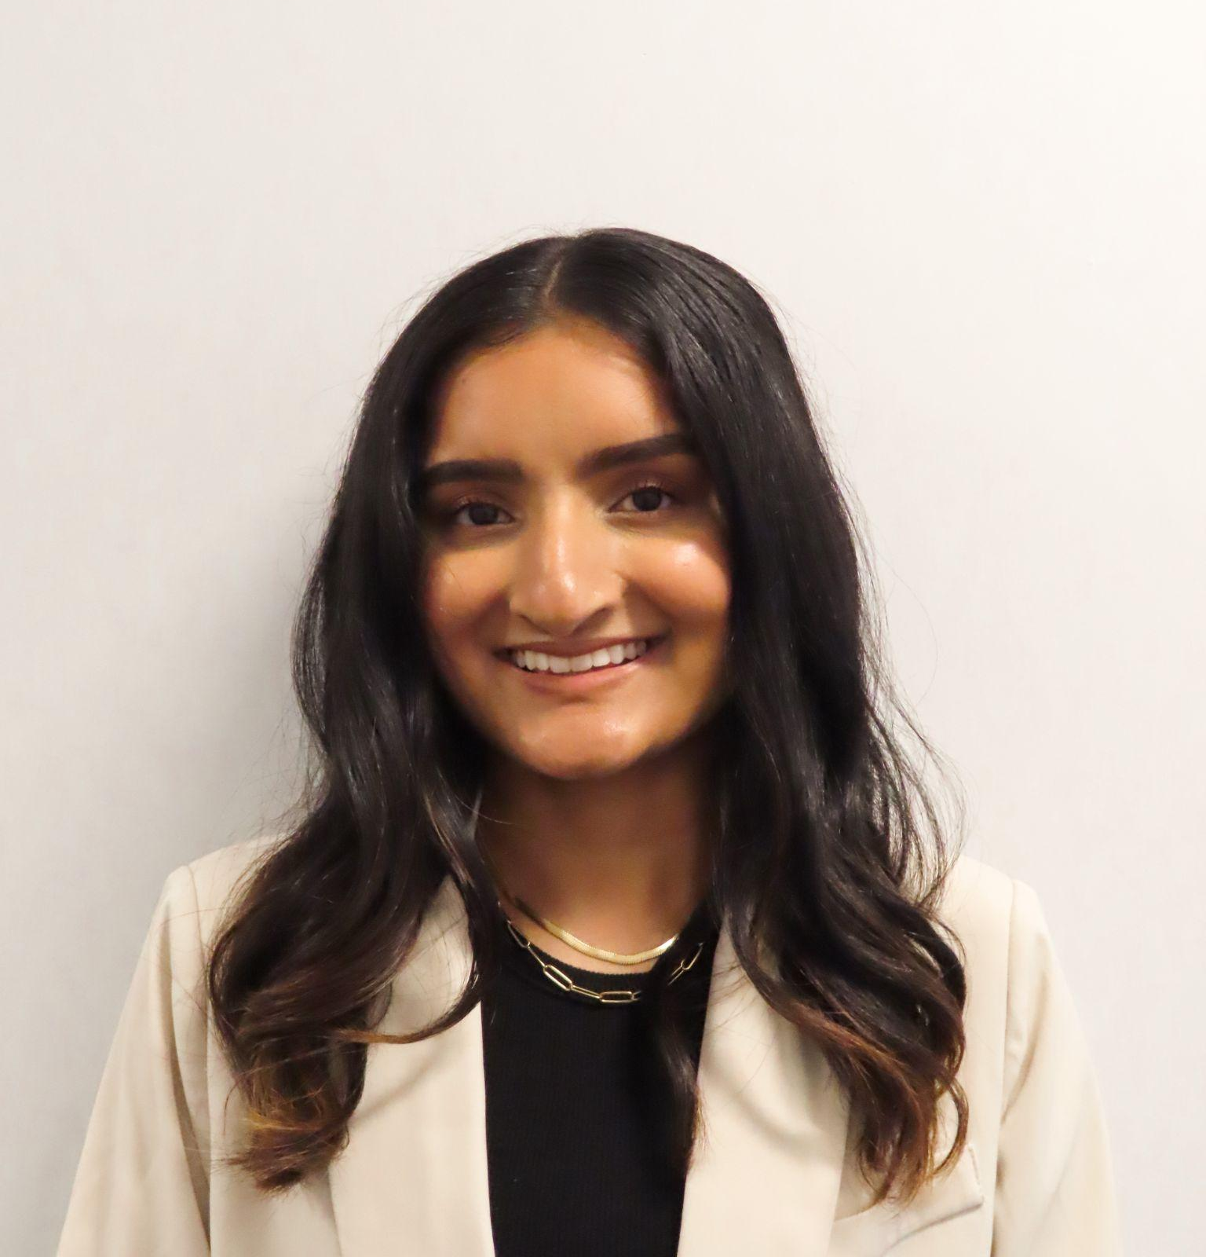

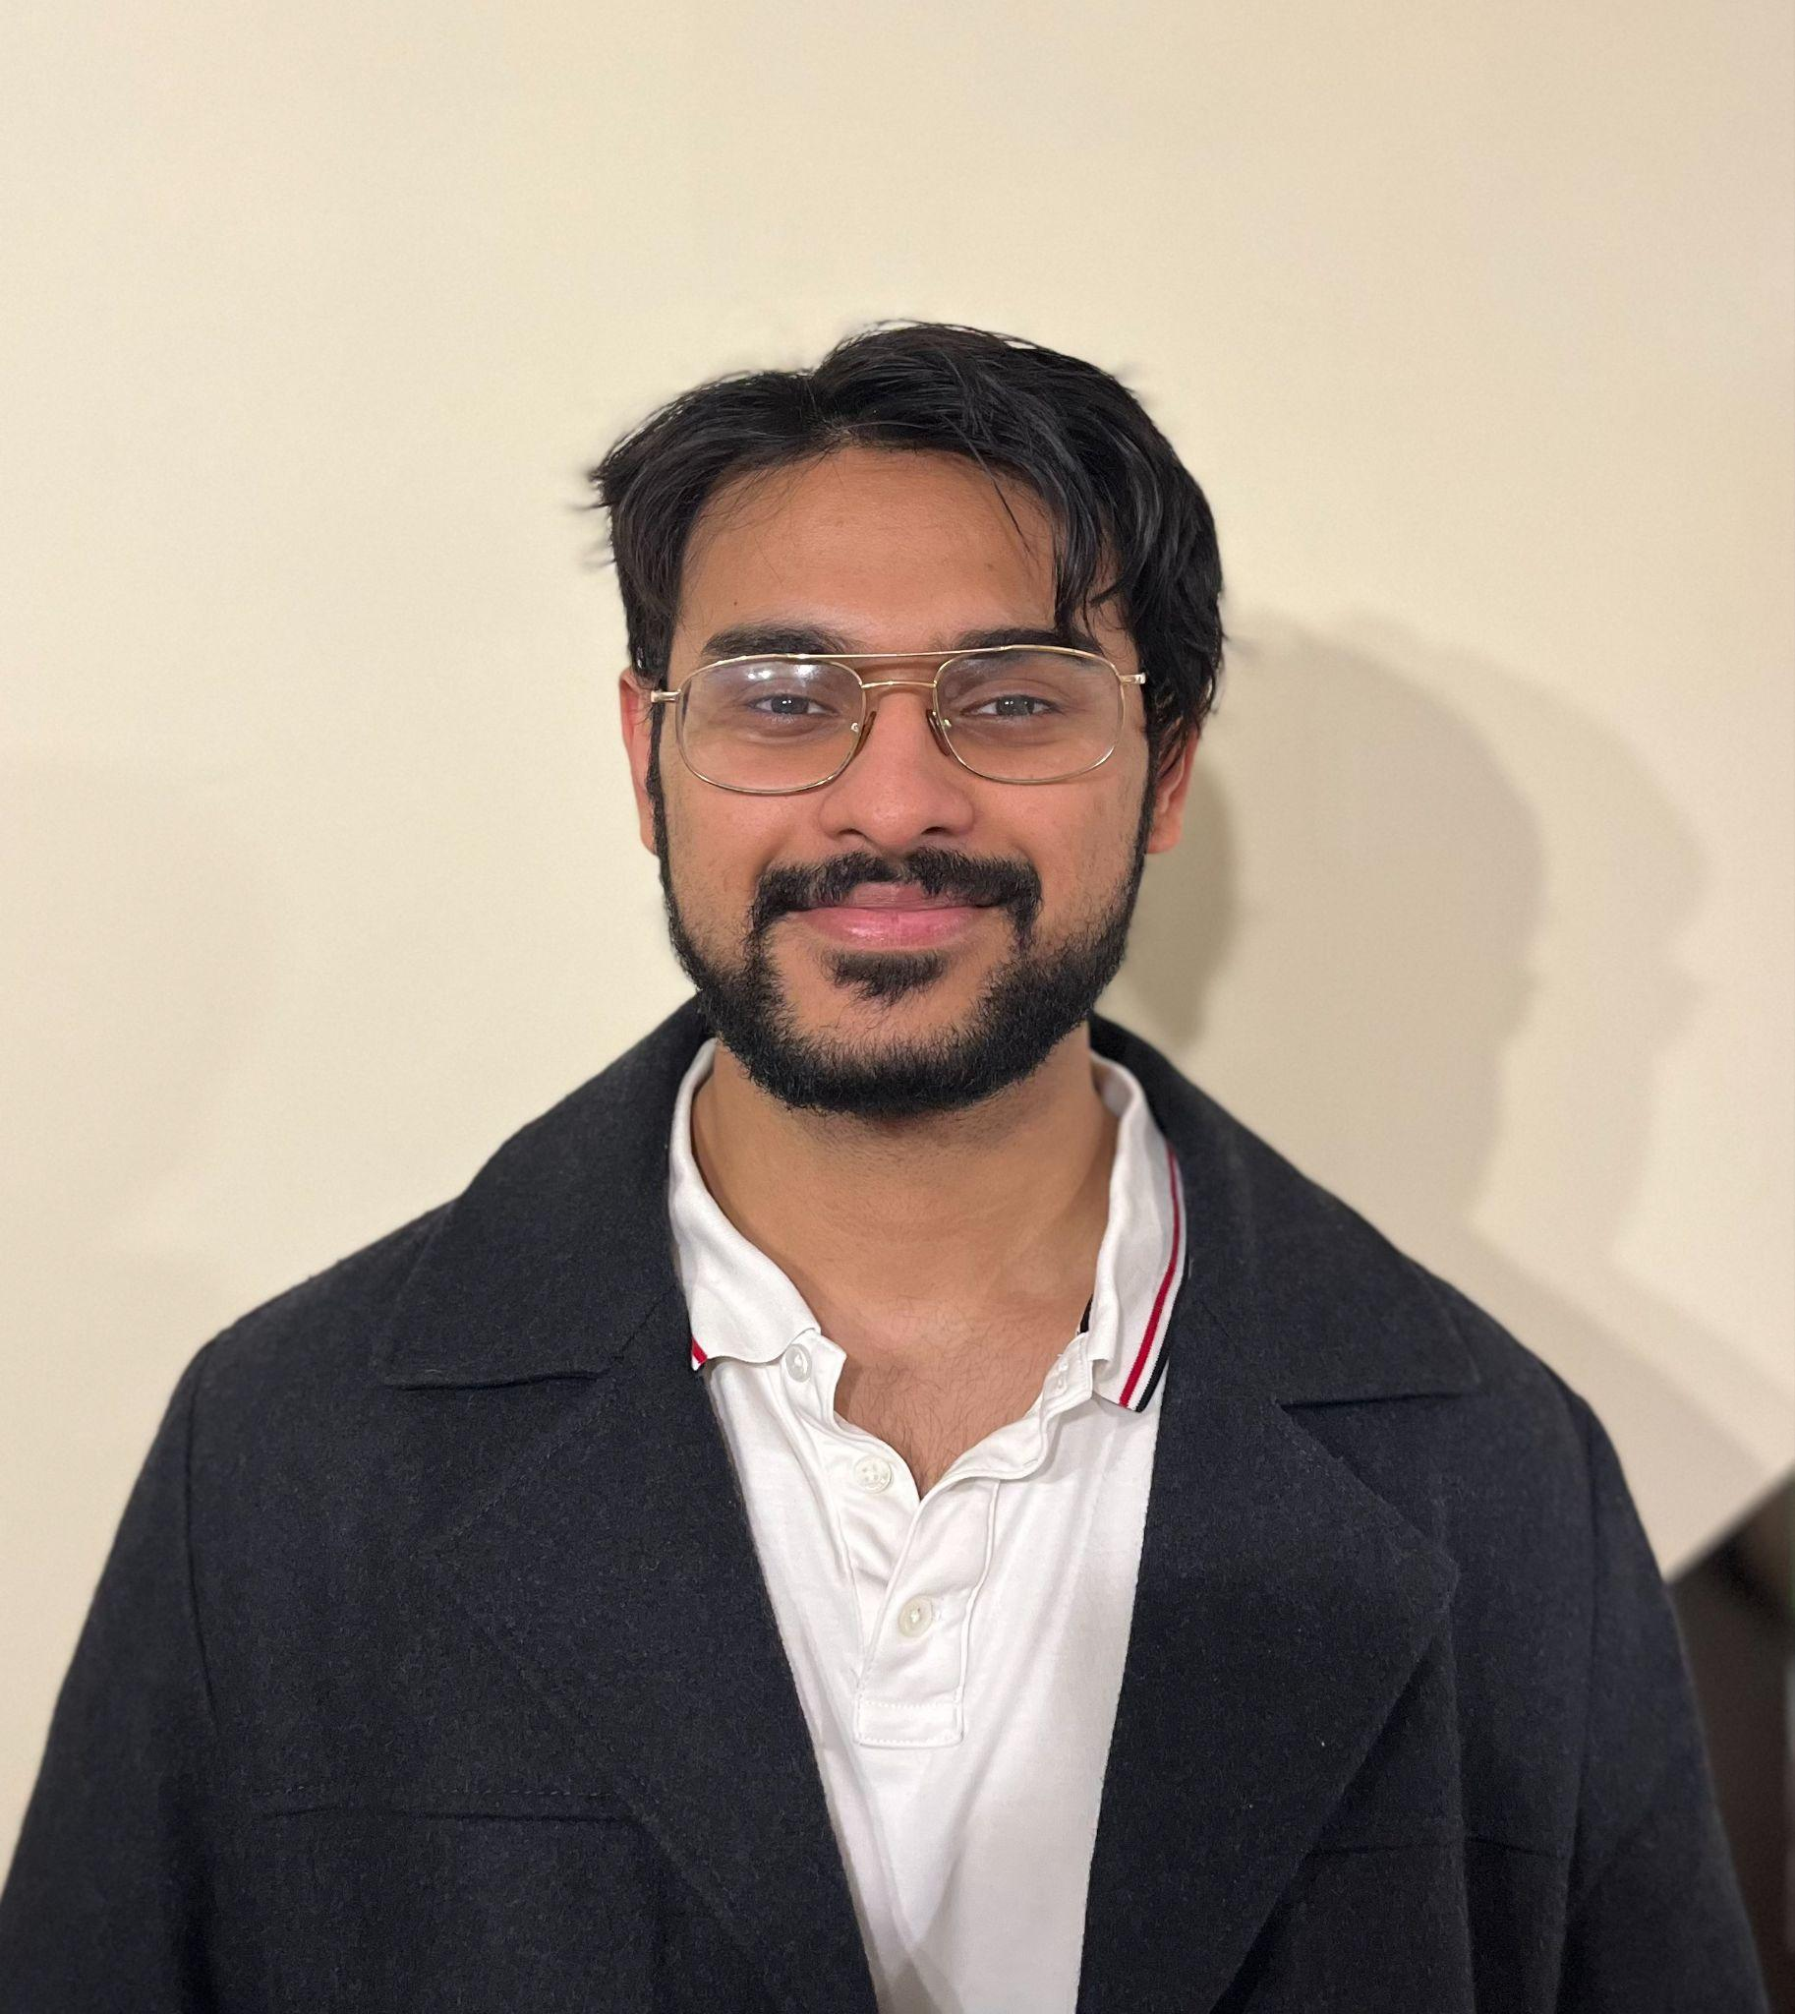

Team Member Responsibilities
Alex
Neeti
Sara
GitHub Manager, FitBit OAuth (Back-End), Firebase Database SetUp
Slides Manager, Navigation (Front-End), Website Development
Baseline + Navigation (Front-End), UI and Website Development
Ahmad
Sohan
User Login + FitBit OAuth (Back-End), Firebase Database SetUp
User Login (Back-End), UML Diagram Updates, Cleaning Code

Slide 4

Introduction to Teamwork
The front-end utilized a React and next.js framework
It was written in TypeScript and Tailwind CSS
We also used plugins like daisyUI for more complex design elements
The back-end was mostly done in JavaScript
The project took many hours due to complex UI
Issues integrating back-end with UI
We would have a few meetings to code for 3+ hours at a time
In addition to the time each person worked individually

Slide 5
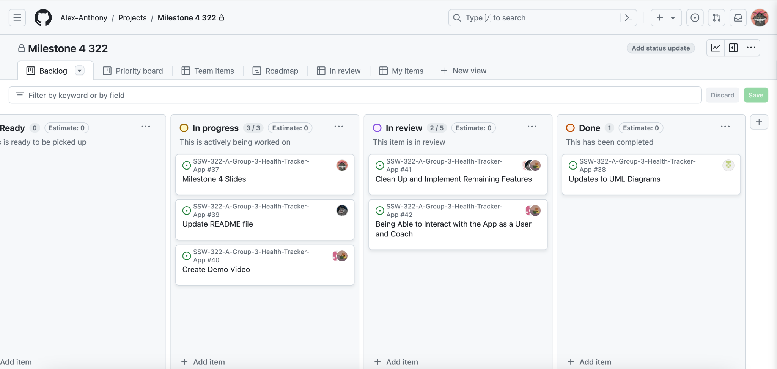
GitHub Project
https://github.com/Alex-Anthony/SSW-322-A-Group-3-Health-Tracker-App

Slide 6
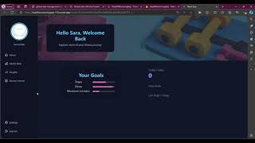
Front-End Demo

Slide 7
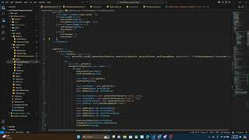
Back-End Demo

Slide 8
Strengths and Challenges
Strengths
Diverse team capabilities in front-end, back-end, debugging, and overall design
Effective and strong collaboration and team management
All working towards a common goal of producing a functioning, aesthetically pleasing, and efficient app
Challenges
Initially coding without committing to GitHub in separate branches which led to difficulties in syncing code and maintaining a working version of the application
Issues with redirecting URLs
Finding shared time to work and discuss progress amidst academic and personal responsibilities

Slide 9
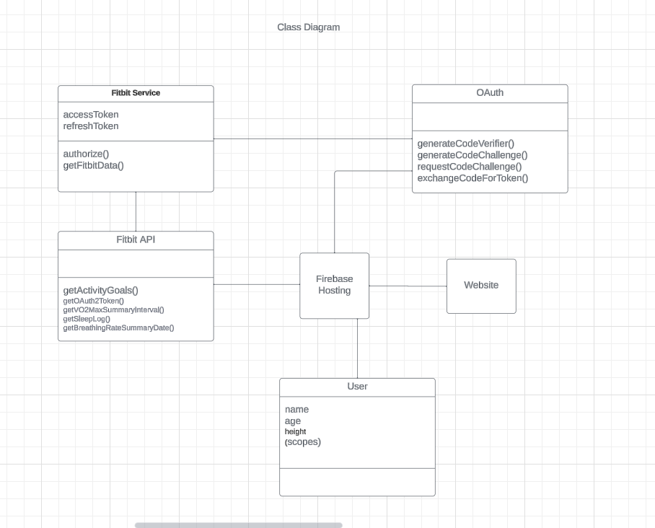
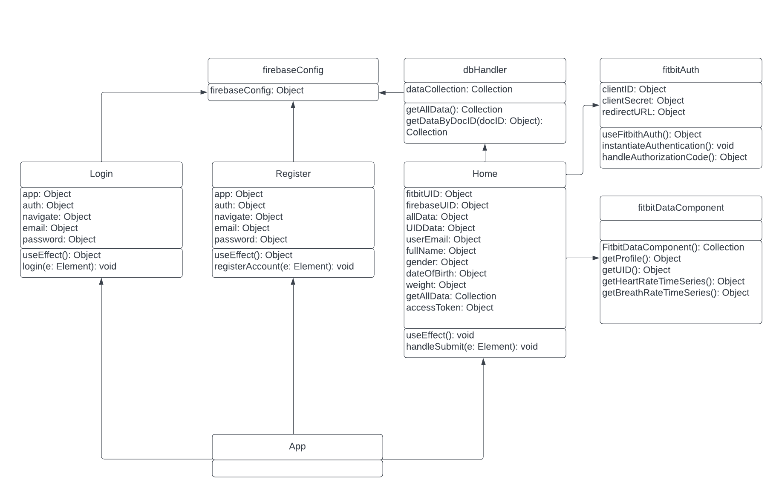
Changes to UML Diagrams
Class Diagram
Notes:
If you have not made any changes to the UML diagrams, then you can just go ahead and show the same ones, and perhaps talk about which modules of the diagrams you worked more closely on for this milestone.

Slide 10
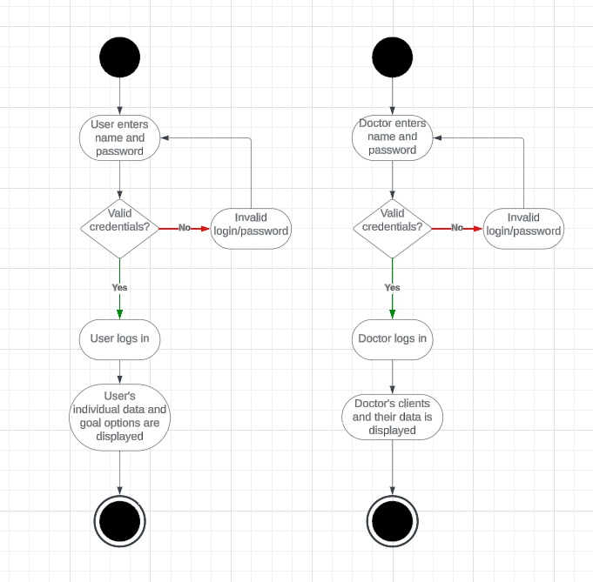
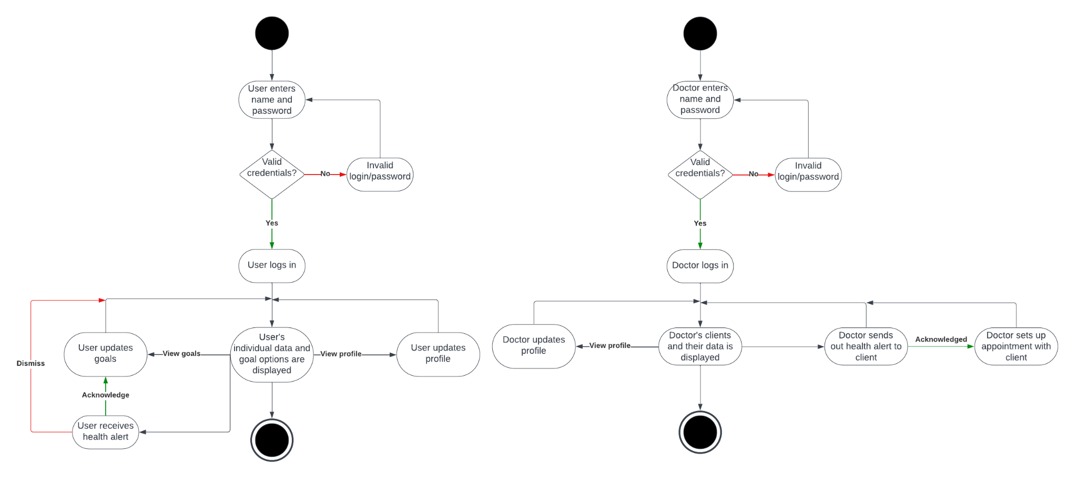
Changes to UML Diagrams
Activity Diagram
Notes:
If you have not made any changes to the UML diagrams, then you can just go ahead and show the same ones, and perhaps talk about which modules of the diagrams you worked more closely on for this milestone.

Slide 11



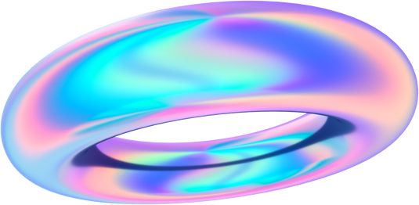

Thank you!
Any Questions?

